Slide 1
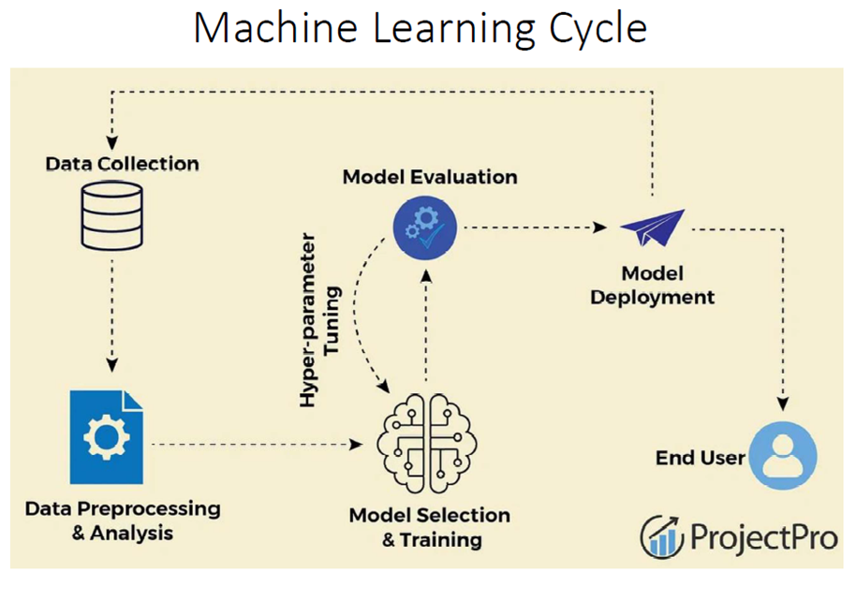
Getting the data, preparing the data
Visualizing the data
1.Selecting and Training a Model
2.Fine tuning a Model:
Grid Search
Randomized Search
4. Main Challenges:
Data Inadequacy
Non-representativeness
Irrelevant features
Overfitting the Model
Underfitting the Model
3. Model Evaluation: Accessing How model works on unseen data
Accuracy, Precision, Recall, MSE, RMSE
Cross Validation

Slide 2
